Slide 1
Summer Internship
Semiconductor Device Modelling using TCAD Simulation Tool
Group II Assignment
Simulate n-channel MOSFET with Si3N4 gate dielectrics of thickness 15 nm and find VT. Justify your result. Find ID-VDS characteristics for three different gate voltages. Estimate whether channel length modulation phenomena is included in the simulation or not. If yes, find the early voltage.

Slide 2
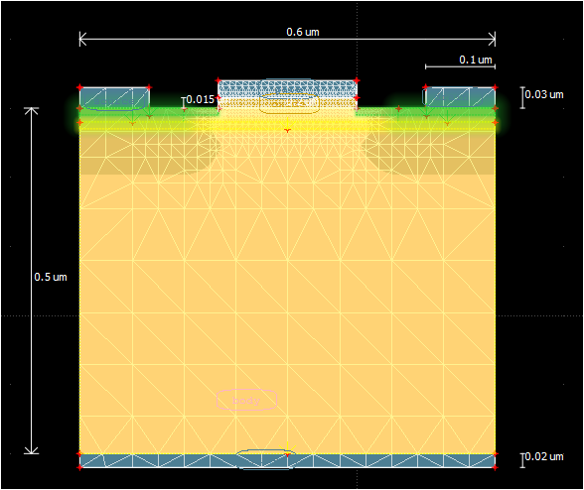
N-MOSFET with Si3N4 oxide layer and 15nm thick

Slide 3
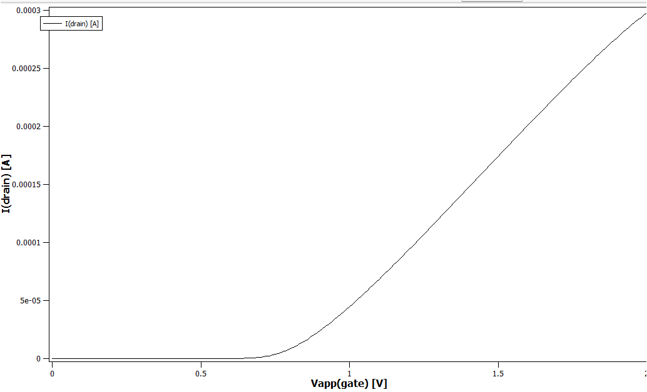
INPUT CHARACTERISTICS
It is graph of drain current I_{D} v/s gate-to-source voltage V_{GS} at a const value of drain voltage V_{D}
Threshold voltage,V_{T}=0.7V

Slide 4
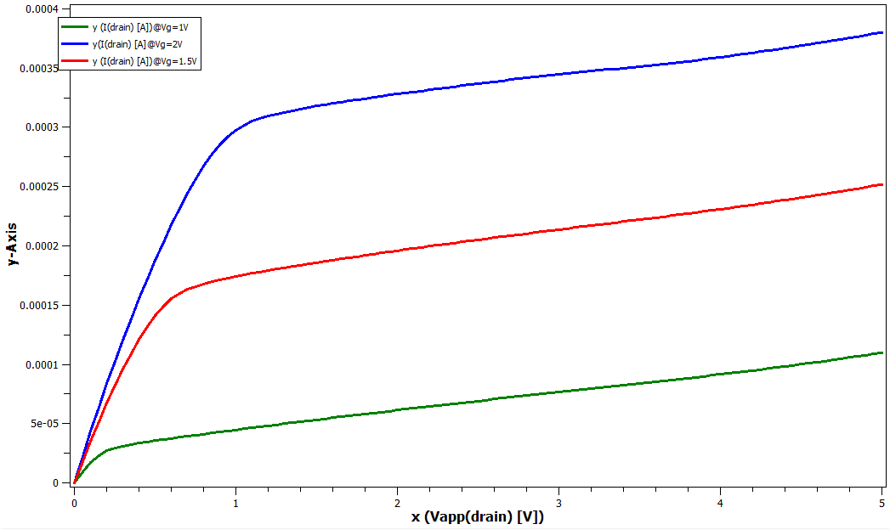
OUTPUT CHARACTERISTICS
It is the graph of I_{D} v/s V_{DS} at const. value of V_{GS}

Slide 5
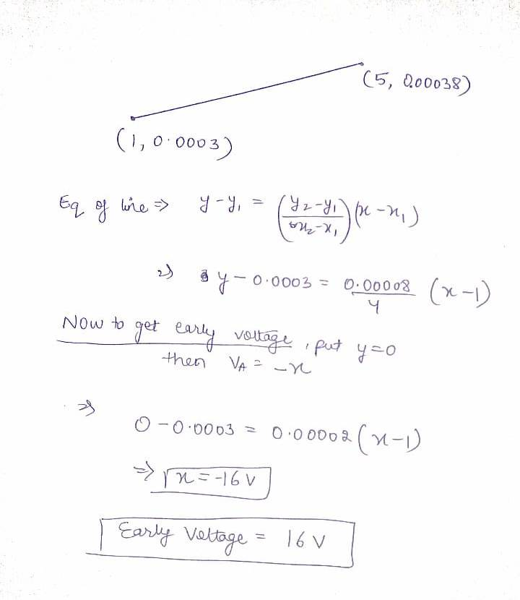
Channel length modulation: Its is the shortening of the length of the inverted channel region with increase in drain bias for large drain biases. In this the order of ΔL is same as of L,so instead of saturating,drain current increases slightly.
Calculation of early voltage
Early Voltage, V_{A} =16V

Slide 6
THANK YOU
-
Kavish Aggarwal
Himani Chauhan
Jatin Kant Gola
Ayushi Bansal
Deepanshi Gupta

